Slide 1
Stitching and Aligning Large Scale EM Volume
December 11, 2018
Gayathri Mahalingam

Slide 2
Overview
Scaling the Stitching and Alignment Pipeline
Workflow engine for Continuous processing
Risks and Mitigations

Slide 3
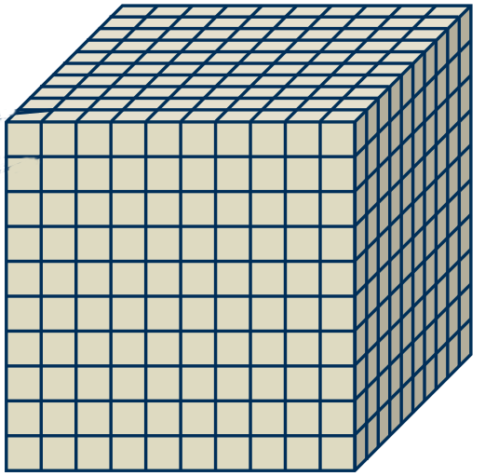
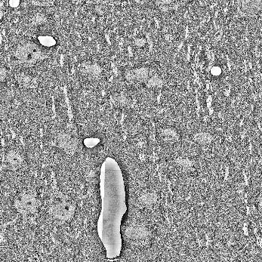
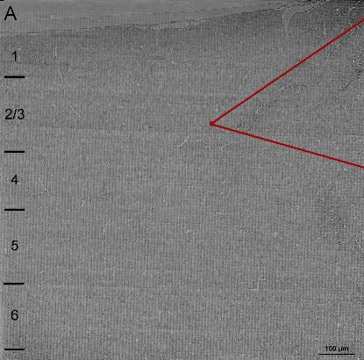
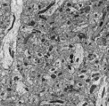
Scaling up of Mouse EM Connectomics Data Sets
Phase 1
Phase 2
(100 µm)³
~2,500 sections
~250,000 images
100 neurons
1 000 000 synapses
1 mm³
~25,000 sections
~250,000,000 images
100 000 neurons
1 000 000 000 synapses

Slide 4
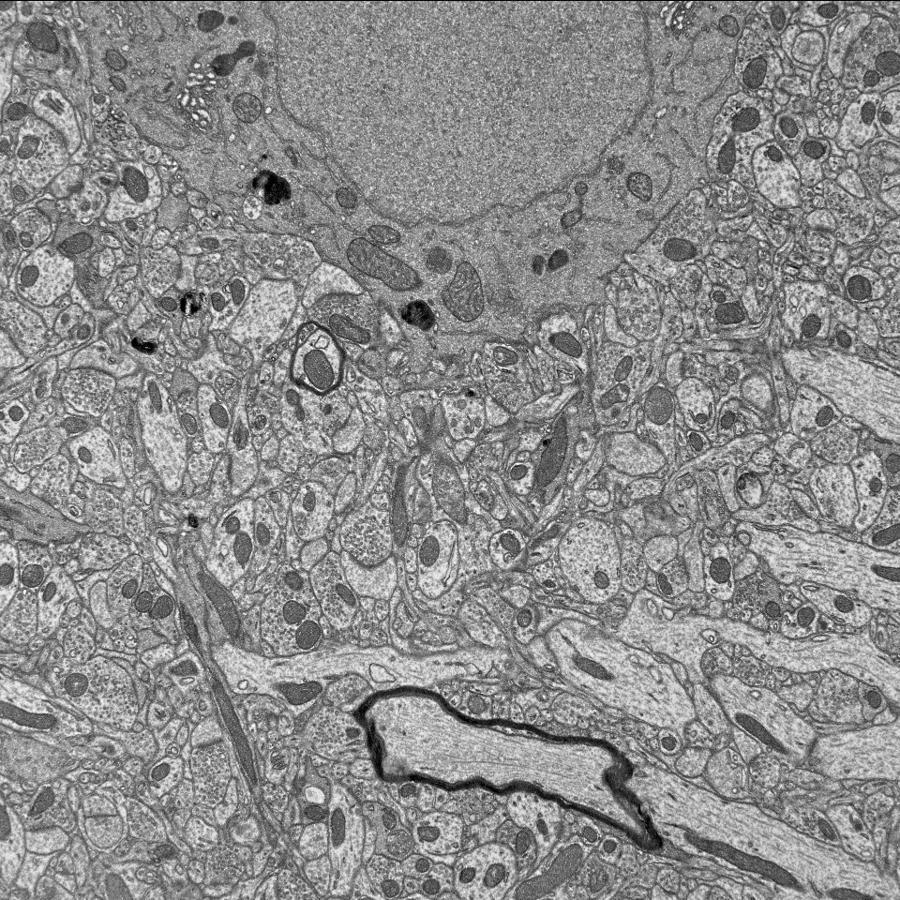
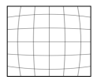
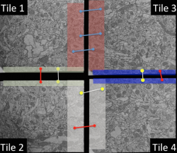
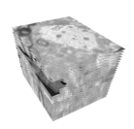
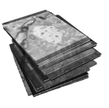
Stitching Pipeline
Lens distortion correction
Stitching/montaging
Flat field corrected tile
Materialization
Fine Alignment
Rough Alignment

Slide 5
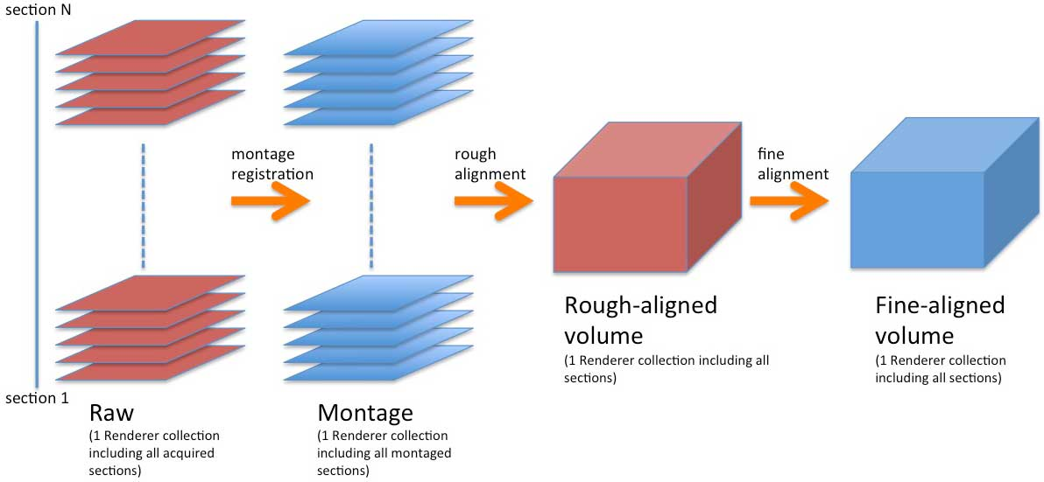
Stitching Strategy – Small Volume

Slide 6
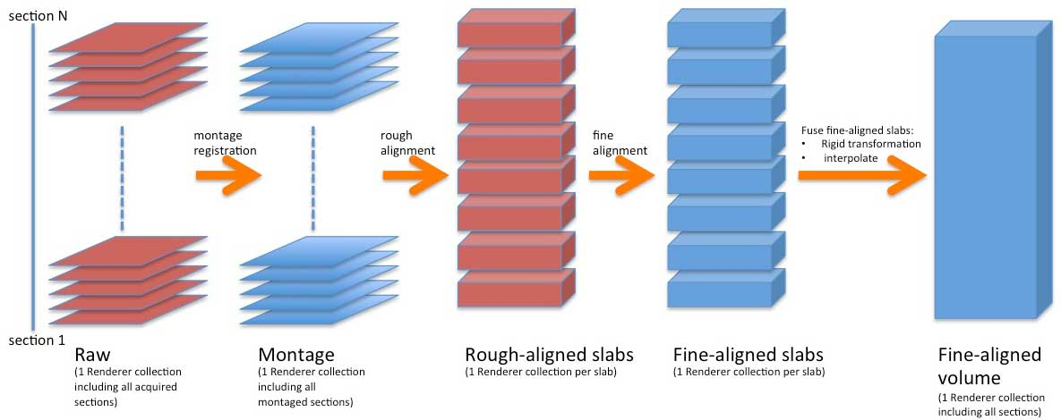
Stitching Strategy – Large Volume

Slide 7
Bottlenecks
Materialize intermediate results to use as input to next step
Consumes disk space
Not efficient (minor error causes re-materialization)
Cannot be scaled to large volumes
Real time stitching is not feasible
Need to keep up with imaging

Slide 8
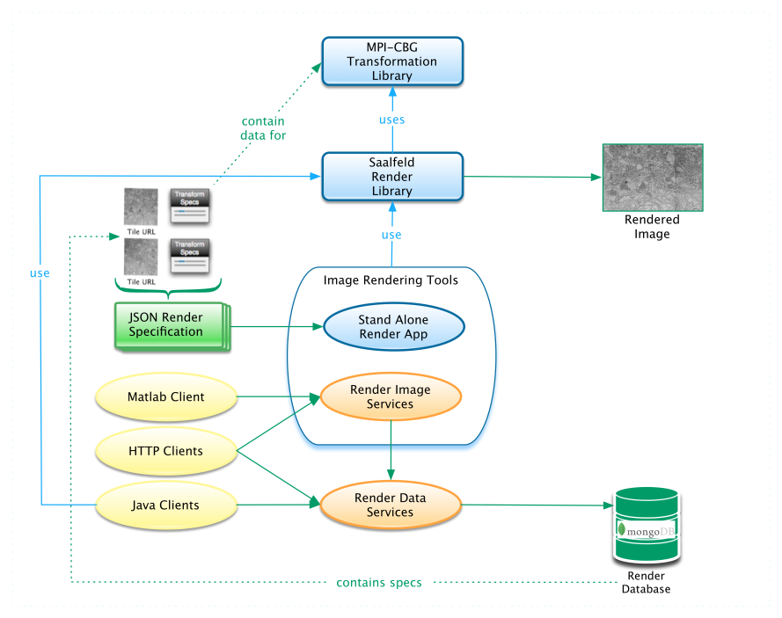
RENDER Components

Slide 9
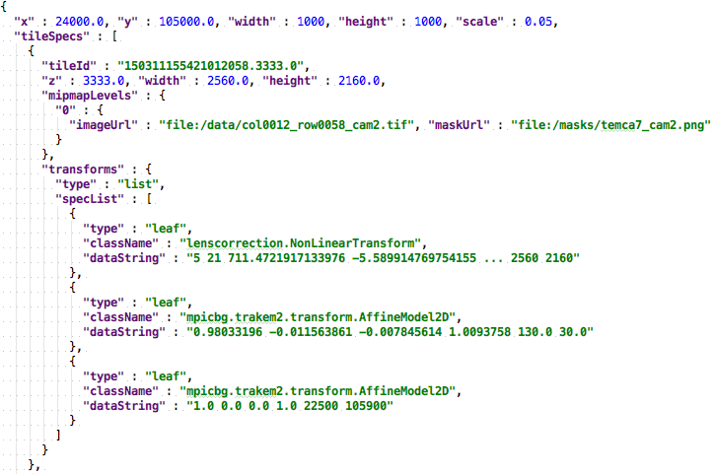
Render Data Model

Slide 10
Render - Advantages
No rendering of intermediate results
Render is modular
Scalable to solve large volumes
Real time stitching is feasible with proper infrastructure
Render utilizes mipmaps for processing
Faster processing
Saves disk space

Slide 11
Stitching and Alignment Using Mipmaps
Render includes logic to utilize the mipmap images at various stages in processing
Moving the raw data to long term storage for later retrieval
Compute point matches
Materialize section montages at a lower scale for QC and rough alignment

Slide 12
Schematic of Current Infrastructure Supporting Stitching¹
From acquisition system
Image meta-data
Image files
G
Stitching-based tasks:
Mipmap generation
Intensity correction
Stitching QC
Data staging for analysis and visualization
Rendering volume to disk
B
Render
Service
Image meta-data
A
Image
Catcher
Tile-spec
Mongo DB
Image files
Primary storage
(Isilon)
Stitching steps:
Montaging
Rough alignment
Fine alignment
Volume assembly
E
C
Solver
(matrix-based registration)
Point-match generator
(SIFT/SURF)
D
Point Match
Service
F
Point Match QC and visualization
Mongo DB
1. In collaboration with Janelia Research Campus

Slide 13



Stitching and Alignment Workflow
Render
A collection of tools and services to render transformed image tiles
Render-python
Python API client and transformation library for Render
Render-modules
Workflow modules for ssEM with Render
Argschema
Flexible module inputs using JSON
EM_Aligner_python
Python/C distributed registration solver
Render-modules
Argschema
Render-python
EM_Aligner_python
Render

Slide 14
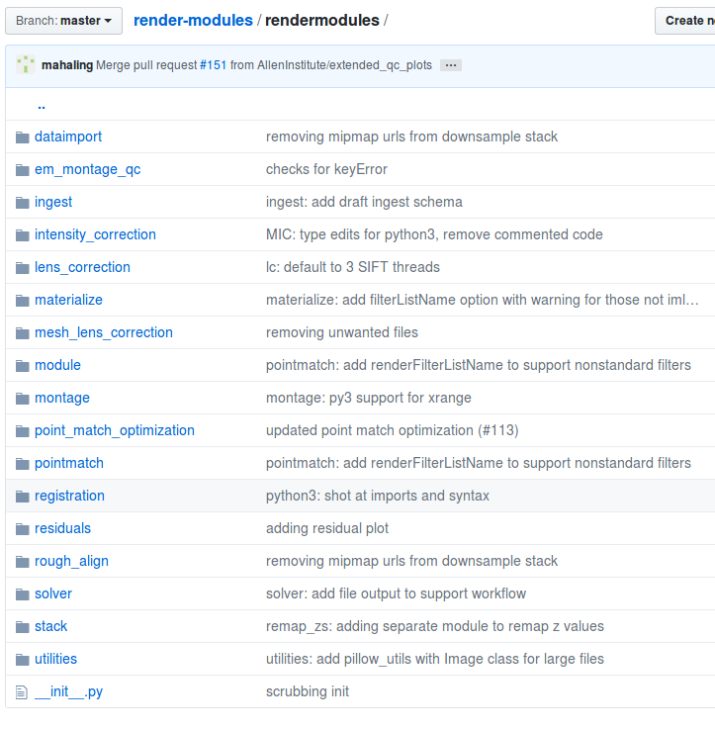
Render-Modules
Python API
Scalable
Works well in distributed systems
Modular
Schemas for data validation
Tools for evaluation and visualization

Slide 15
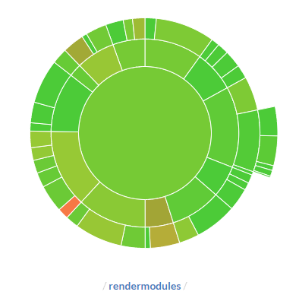
Render-Modules
Docker based solution for rapid deployment and portability
Formalized continuous integration and deployment using Bamboo, Artifactory, and Ansible services
MATLAB, Java, Python, Apache Spark, etc.
Integration tests for each module for seamless development and code coverage

Slide 16
Phase 2 – Quality Control

Slide 17
Stitching Issues
Stitching errors are mainly caused due to
Presence of holes (missing tiles in montages)
Stitching gaps (no overlap between tile images)
Seams (mainly caused due to poor-point correspondences)
Automated tools to detect these issues have been developed and integrated with the Python API

Slide 18
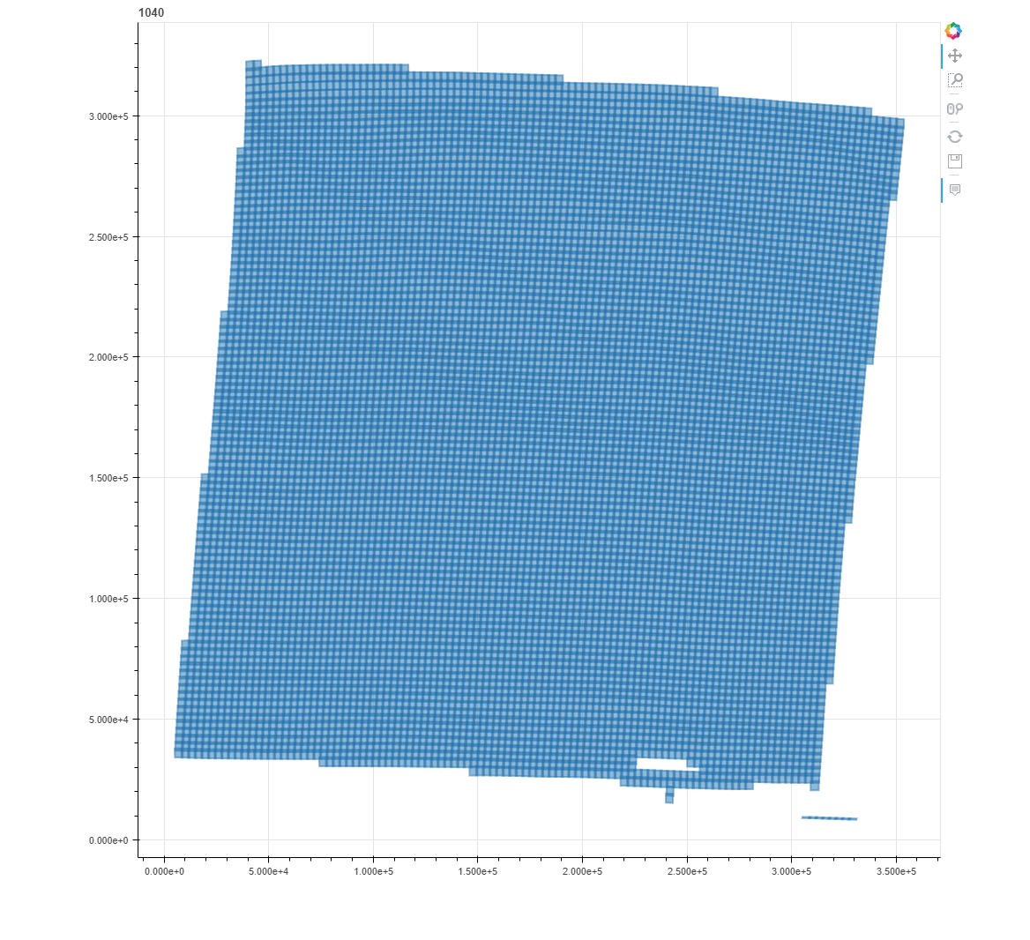
Stitching Issues - Holes
Missing tiles in montages
Tiles get dropped due to insufficient point matches
Tiles that are part of blood vessels
Solved by generating point matches at a higher scale

Slide 19
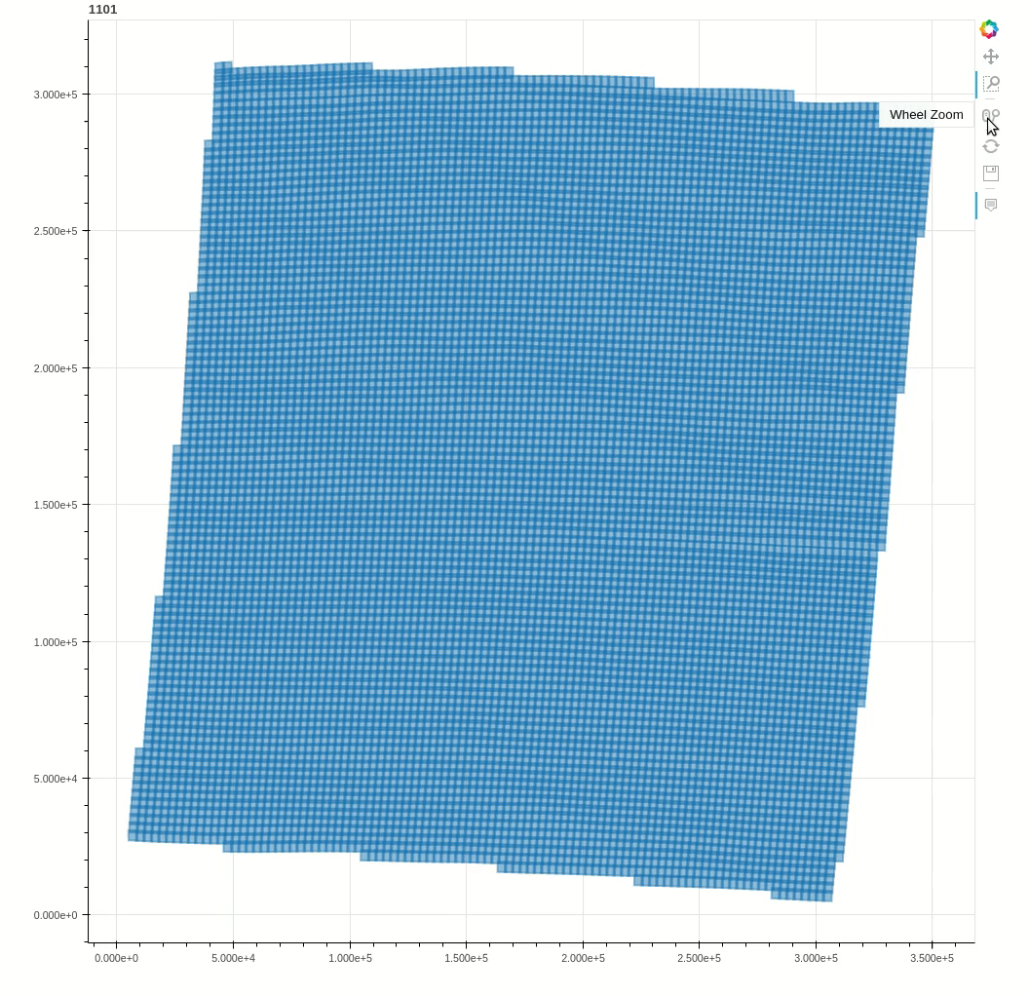
Stitching Issues - Gaps
Gaps in stitching are introduced due to insufficient overlap between tiles
- resolved by introducing QC at the imaging stage

Slide 20
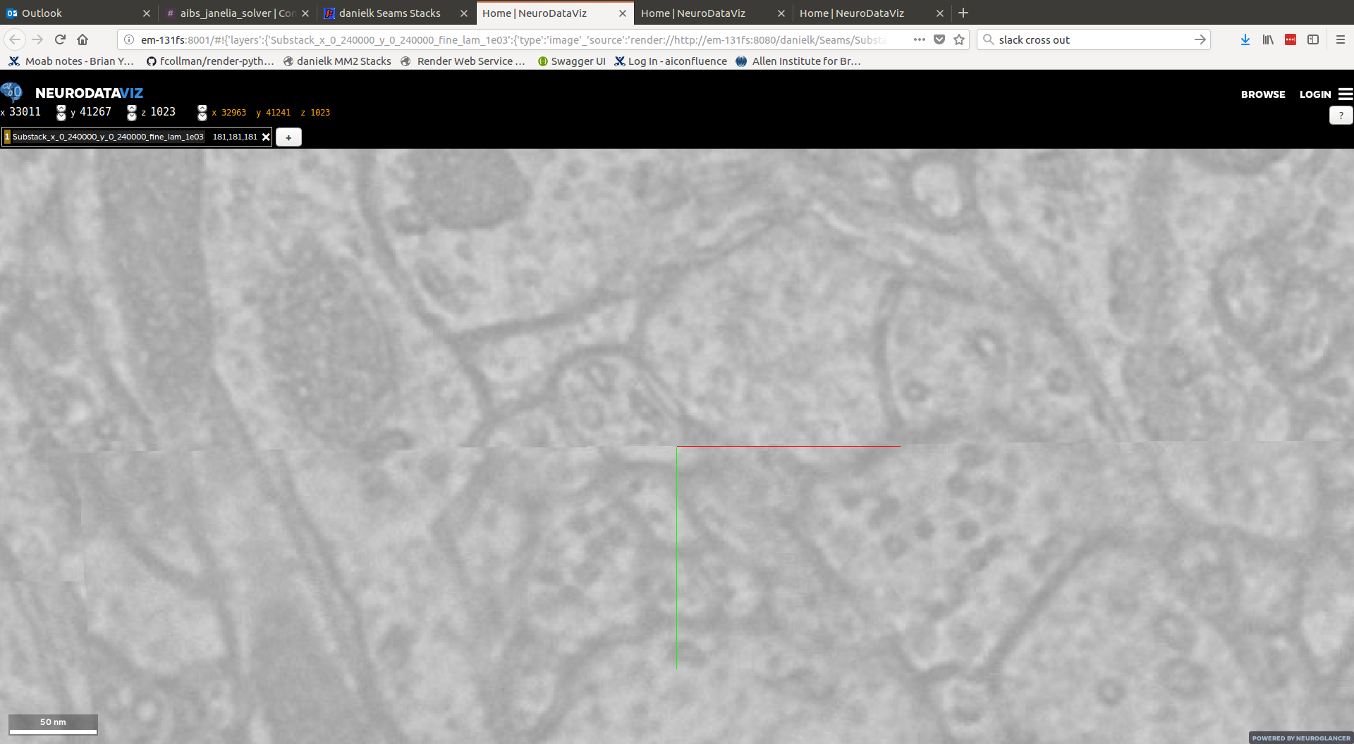
Stitching Issues - Seams
Seams occur due to misalignment between tiles within section
Seams are caused due to
Poor point matches between tile images
Inaccurate lens correction transformation
In 3D alignment, seams are mainly caused due to cracks

Slide 21
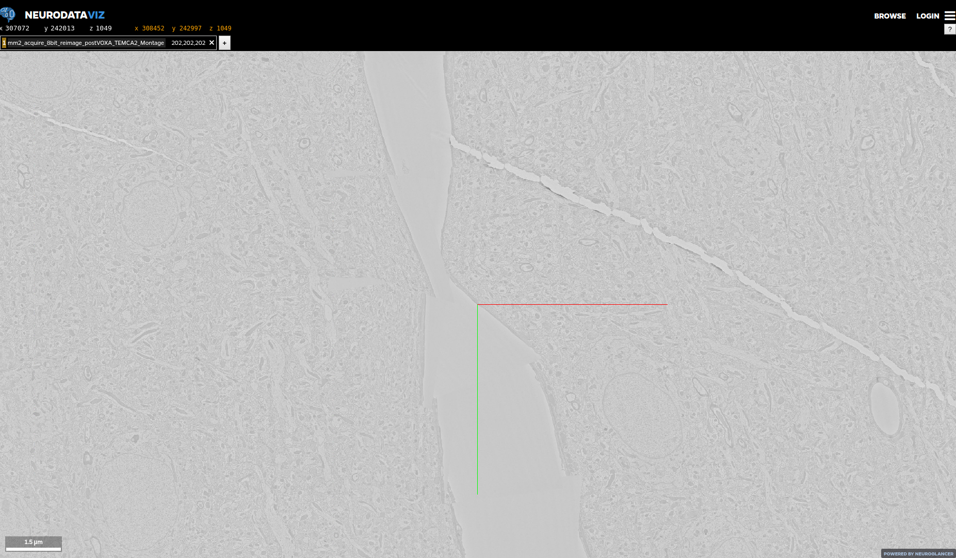
Stitching Issues - Misalignment

Slide 22
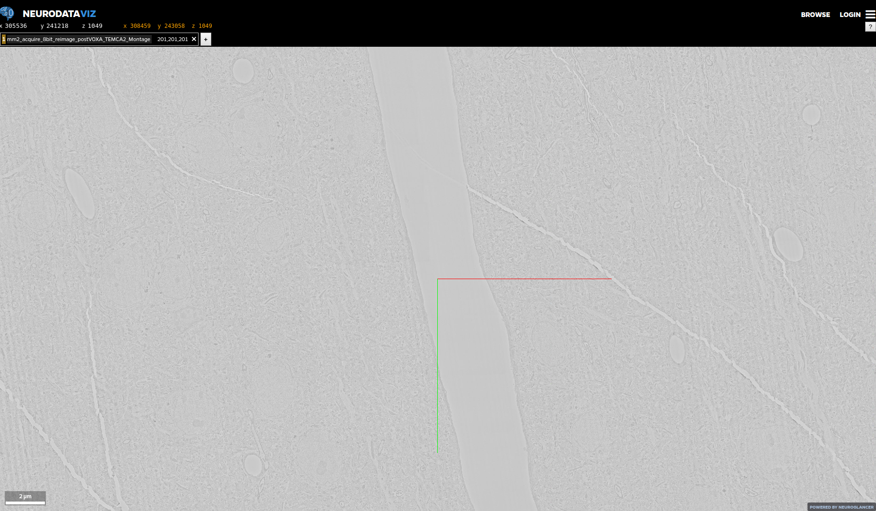
Phase 2 - Misalignment

Slide 23
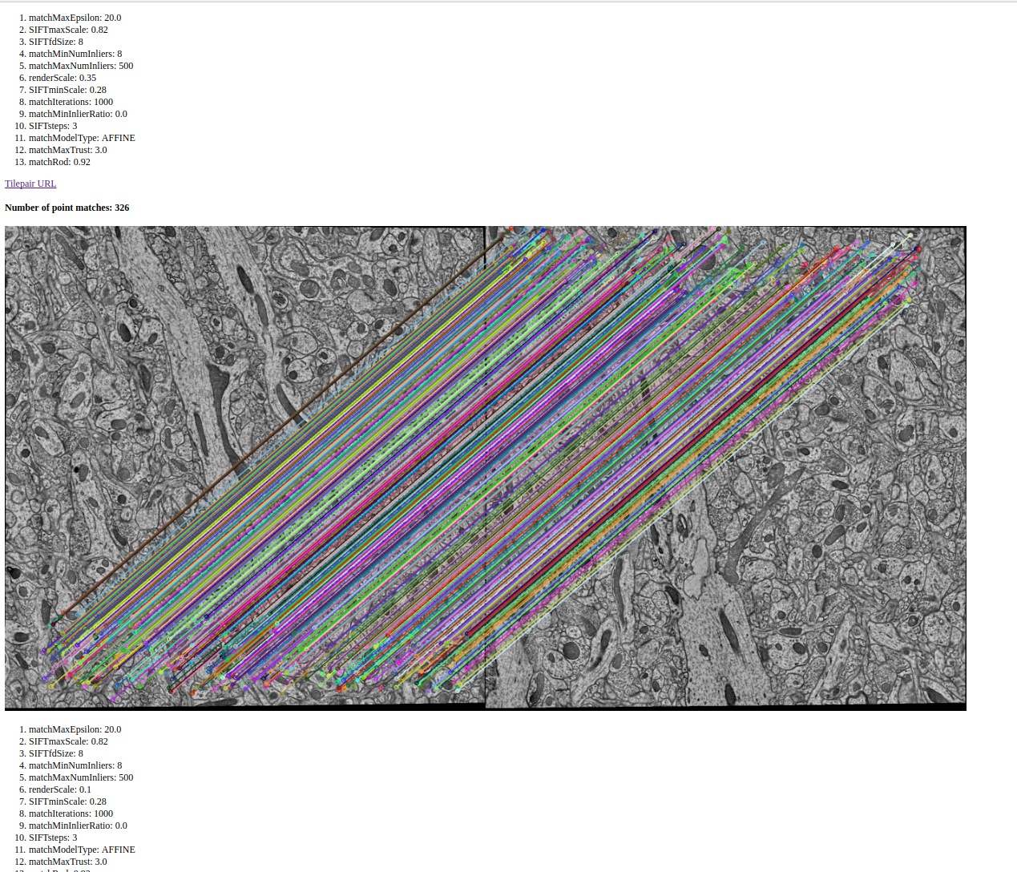
Render-Modules
Point-Match QC and Optimization
Point matching is computationally expensive
Optimized set of parameters that yields good set of point matches for a pair of tiles

Slide 24
Scaling the solver

Slide 25
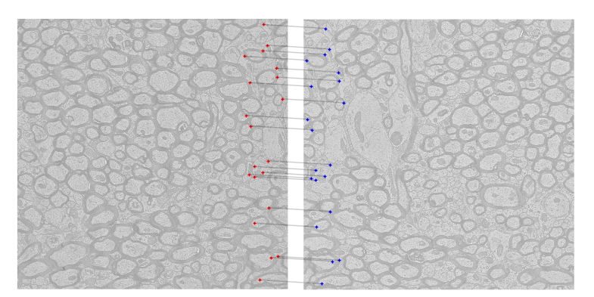
Pointmatches
Features from 2 different images

Slide 26
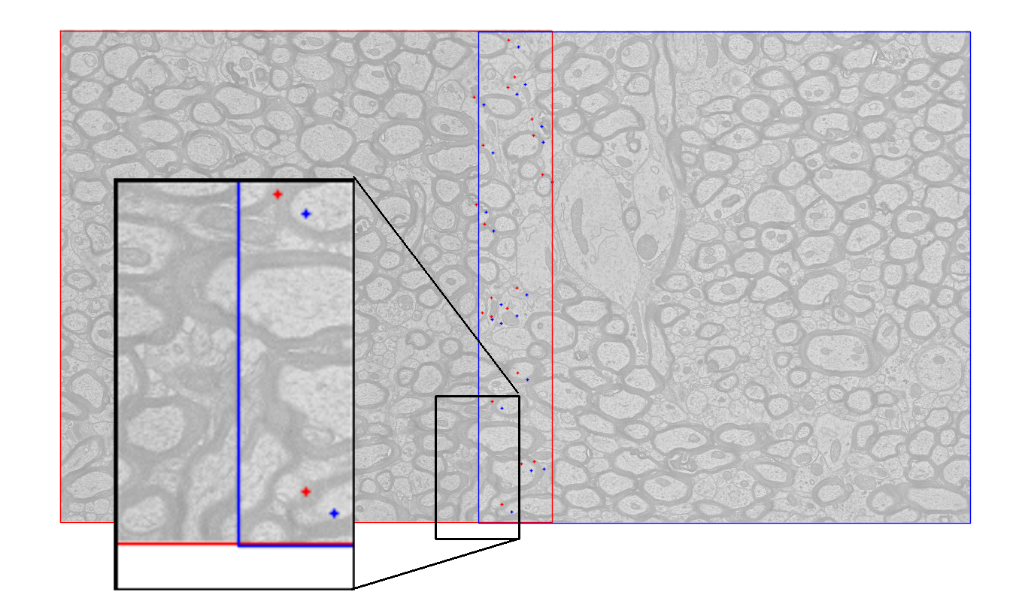
Alignment
Segmentation requires alignment of 1-5 pixels (3-15nm)
Tissue deformation, microscope positioning uncertainties are larger
Image deformation required to align

Slide 27
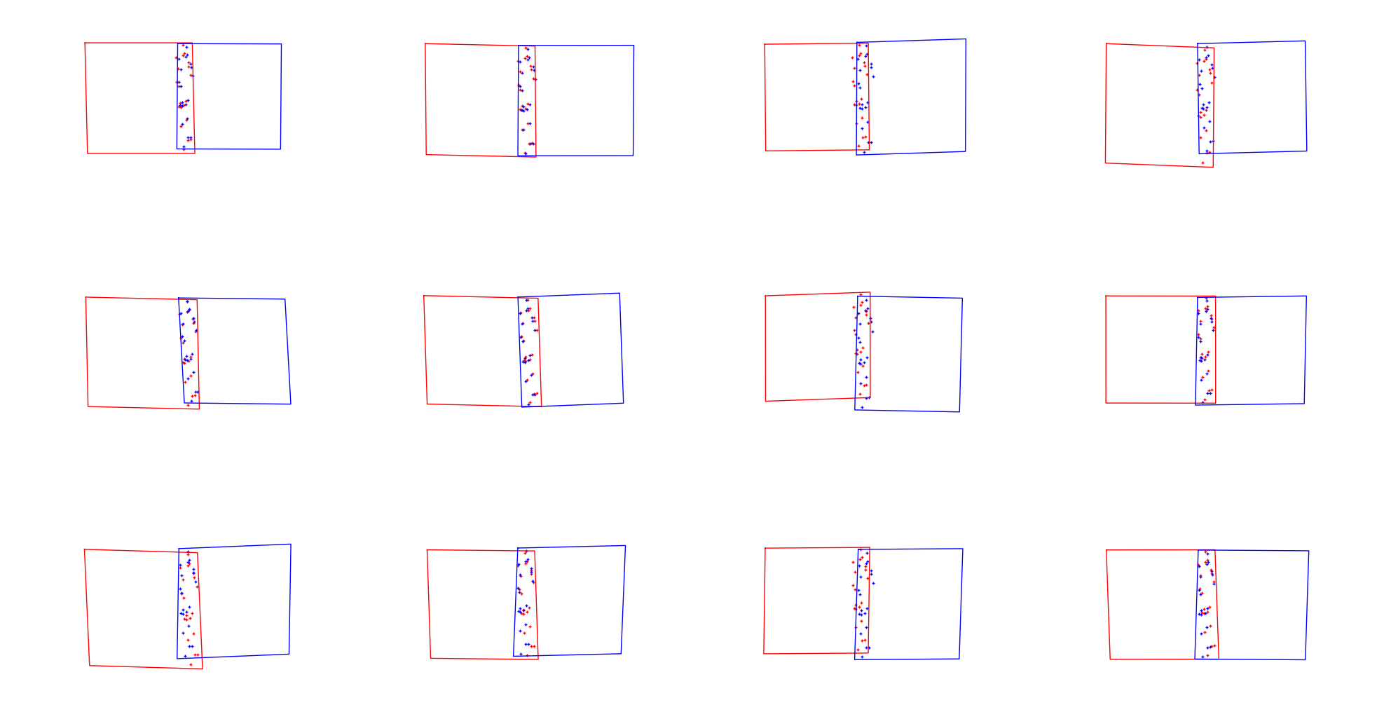
Affine Transformation

Slide 28
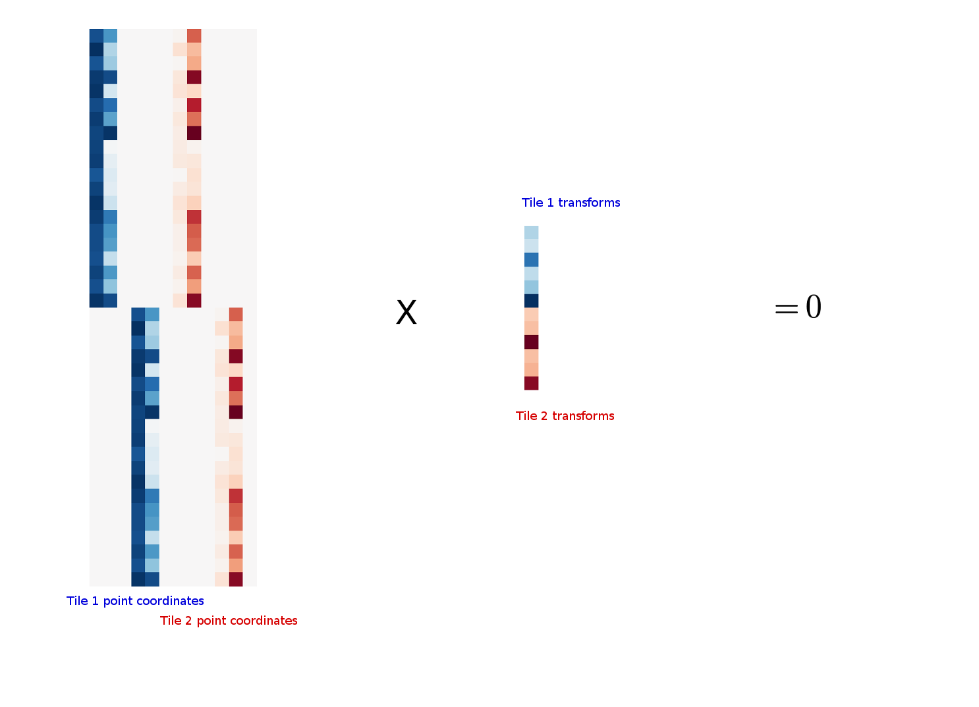
Matrix Form

Slide 29
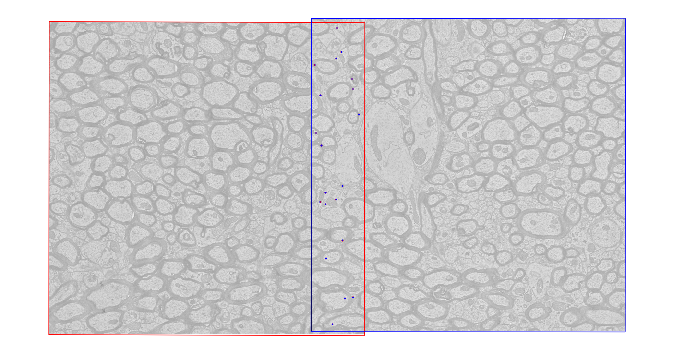
Aligned

Slide 30
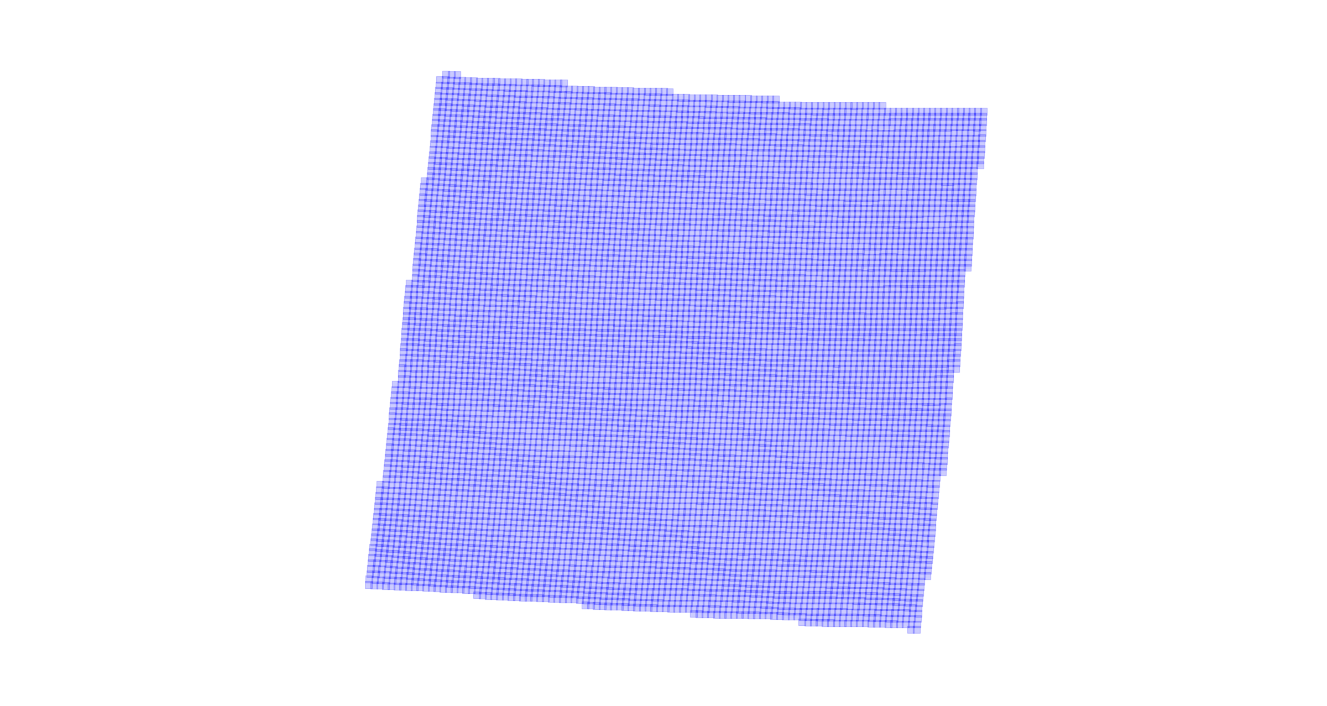
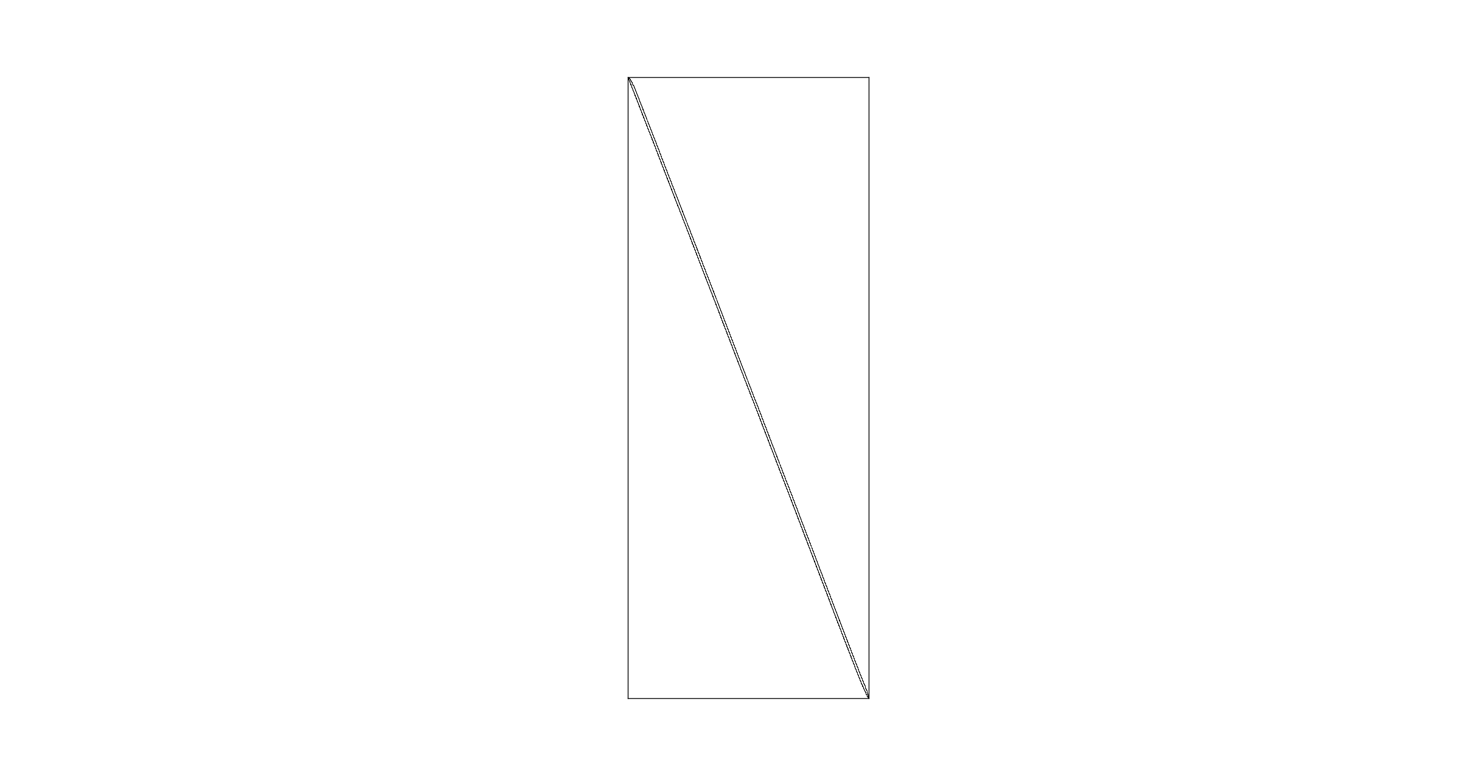
Scaling: matrix size grows quickly

Slide 31
EM Aligner Distributed
Implementation is based on EM_aligner – developed at HHMI
A Python and C based implementation
For easy integration with stitching pipeline modules
For easy access to distributed solvers
 | EM_aligner | EM_aligner_distributed
Target dataset | Full adult fly brain | 1mm² mouse visual cortex
Dataset size | 100 TB | 3500 TB
Language | MATLAB | Python+C
Single-node assembly limit | 1000 1mm² sections
Multi-node assembly limit | N/A | No limit
Single-node solve limit | 200 1mm² sections
Multi-node solve limit | N/A | No limit
Code base | 10-100 files | 5 files

Slide 32
Image Processing Workflow
Integrated Imaging and Image Processing Workflow for Petascale Serial-Section Microscopy

Slide 33
Image Processing Workflow
Continuous processing workflow
5 ATUM reels → 5 starting points
Essentially 5 sub volume datasets with final registration step
Dialogue with Princeton suggests :
Angular misalignments are problematic
Better to have as much rough aligned data as possible
Rolling delivery of aligned sub volume images preferred
Cloud-based delivery (e.g. Snowball)
“Fusion” by transformation interpolation reduces jitter between deliveries

Slide 34
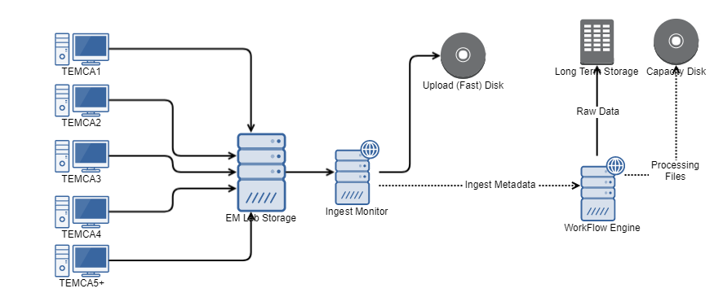
Data Flow Diagram
Specialized services connect high-throughput microscopes to shared institute resources in order to govern disk usage

Slide 35
Image Processing Workflow
Blue Sky Workflow Engine
Allows continuous processing for complex workflows -- currently being developed internally by Tim Fliss
Django backed by PostgreSQL database – stable backups, graceful restarts, and easy migrations
Uses Celery and RabbitMQ to run diverse workflow tasks, e.g.:
Cluster submissions (PBS)
Remote/local Execution
Ingest Workers
Readable, flexibly defined (YAML/JSON/Django) workflow diagrams allowing rapid development

Slide 36
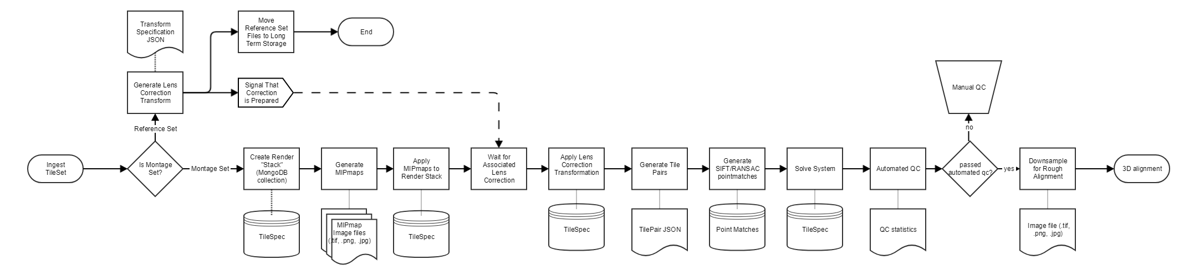
Montage Workflow Diagram
IARPA MICrONS Phase 2 Montage workflow with support for Lens Correction and Manual intervention

Slide 37
Montage Workflow DAG
graph:
- [ "ingest_tile_sets", [ "generate_lens_correction", "generate_em_montage" ] ]
- [ "generate_lens_correction", [ "move_reference_set" ] ]
- [ "generate_em_montage", [ "generate_mipmaps" ] ]
- [ "generate_mipmaps", [ "apply_mipmaps" ] ]
- [ "apply_mipmaps", [ "wait_for_lens_correction" ] ]
- [ "move_reference_set", [ "wait_for_lens_correction" ] ]
- [ "wait_for_lens_correction", [ "apply_lens_correction_new" ] ]
- [ "apply_lens_correction_new", [ "create_tile_pairs" ] ]
- [ "create_tile_pairs", [ "2d_montage_point_match" ] ]
- [ "2d_montage_point_match", [ "solver" ] ]
- [ "solver", [ "detect_defects" ] ]
- [ "detect_defects", [ "wait_for_manual_qc" ] ]
- [ "wait_for_manual_qc", [ "downsample", "move_raw_montage_set" ] ]
- [ "downsample", [ "alignment" ] ]
Same EM workflow represented in YAML as DAG

Slide 38
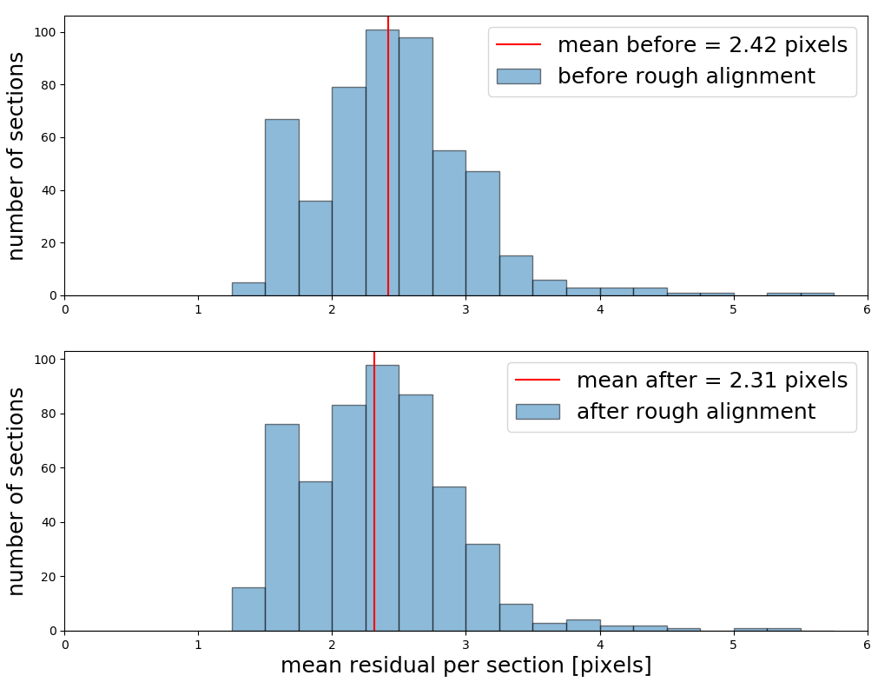
Phase 2 Processing
Montaging
In par with Imaging
~ 15K sections ingested and processed
Perfect montaging without misalignments
Mean residual pixel error rate < 5px

Slide 39
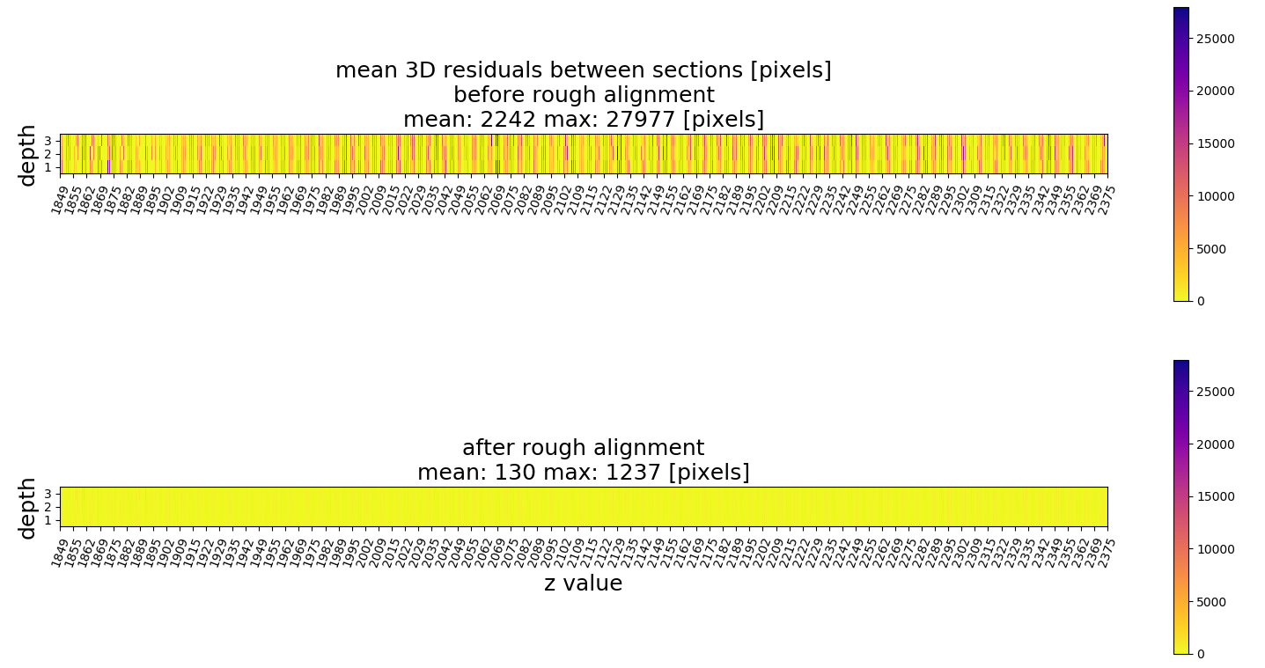
Phase 2 Processing
Rough Alignment Requirements
No stitching/alignment errors
Mean 3D residuals preferably < 1000px

Slide 40
Risks and mitigation

Slide 41
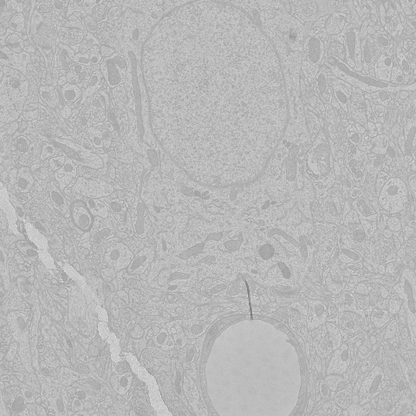
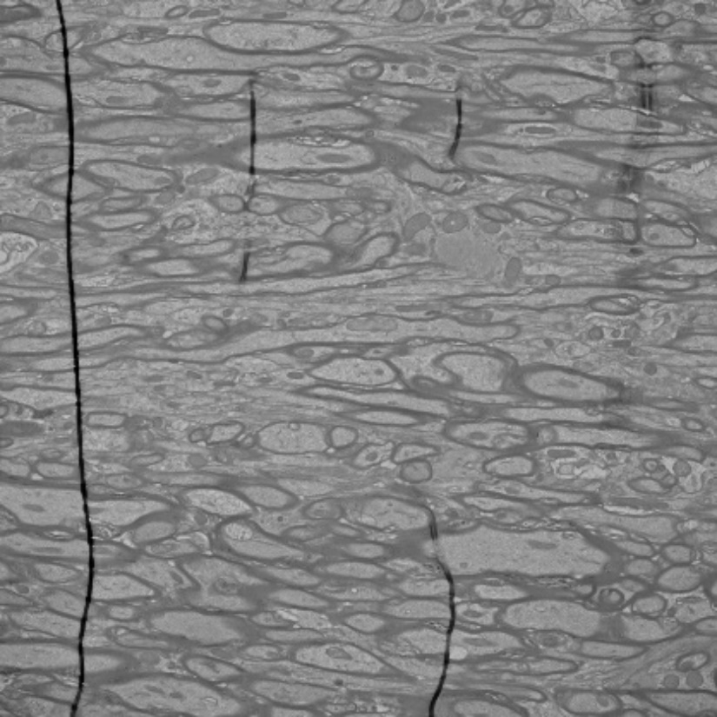
Cracks and Folds
Cracks
Folds
Notes:
fold
20180624142333436_17797_1R_Tape162_TEMCA3_01_reimaging_000017_0_64_39.png
crack
20170503141606362_295434_5LC_0064_01_001043_0_5_25.png

Slide 42



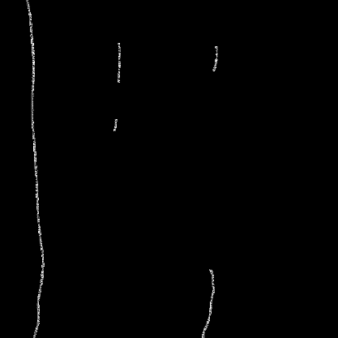
Segmentation
Deep Neural Network Segmentation
Pre-processing
Binary annotations
Image resizing
Training
U-Net convolutional neural network
Input: EM tile
Output: Predicted binary mask
Post-processing
Denoising
Contour identification
Training Inputs: Original EM Image (left) and Binary Mask (right)
Notes:
Mention sample sizes in person
M
Optimization function: stochastic gradient descent
Loss function: binary cross entropy

Slide 43
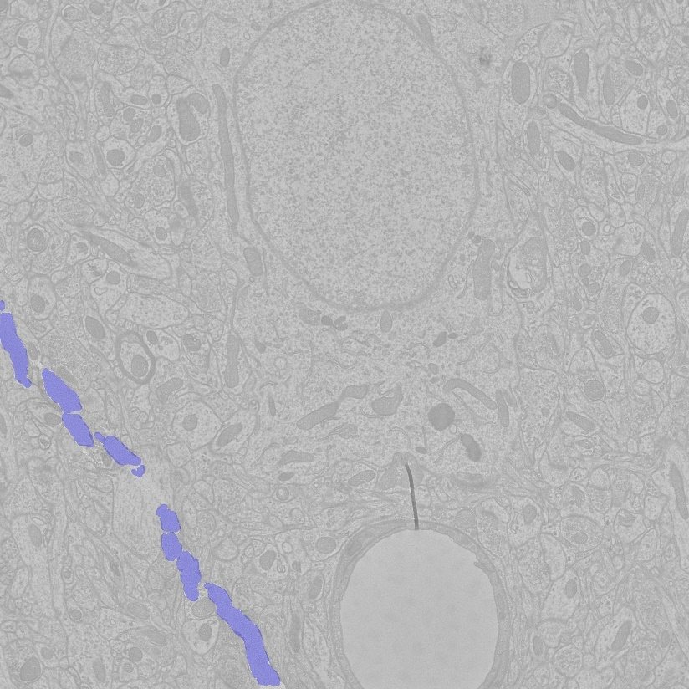
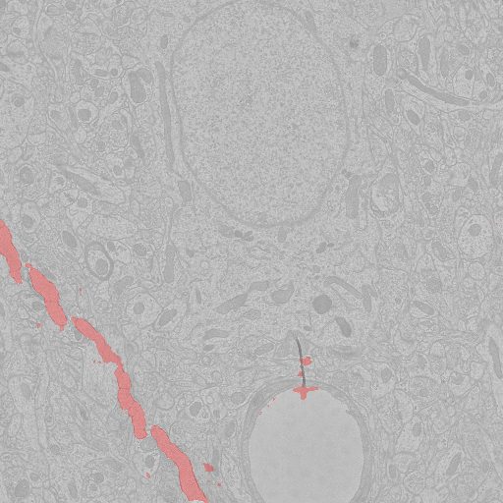
Initial Results (Cracks)
Original EM Image
Labelled Crack Mask
Predicted Crack Mask

Slide 44
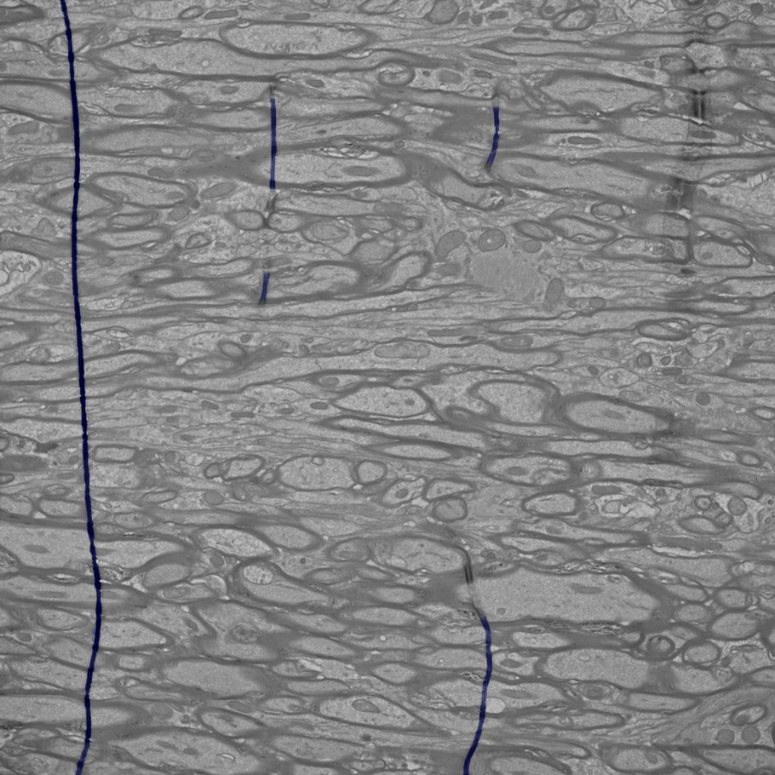
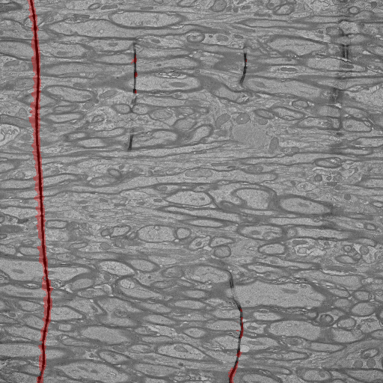
Initial Results (Folds)
Original EM Image
Predicted Fold Mask
Labelled Fold Mask

Slide 45
Initial Results – Errors
Errors
False positive pixels
Blood vessels
Resin edges
Noise
Edge blurring
Contour Holes
Initial Crack Detection Statistics
 | Dice Similarity Coefficient | Fractional Difference
Median | 0.89 | 0.0064
Mean | 0.82 | 0.0073
Standard Deviation | 0.20 | 0.0043
Notes:
Princeton annotations and dataset differences
(Reference dataset for statistitcs)

Slide 46
Initial Results – Errors
Errors
False positive segmentation of blood vessels and resin-tissue intersections
Solutions
Add examples of blood vessels and resin-tissue intersections to training data
Large noise objects
Contour thresholding
Edge blurring and general noise
Replace random crop transformation with resize
Non-local means denoising
Contour Holes
Contour flood filling
Notes:
Piece by piece error & solution matching

Slide 47
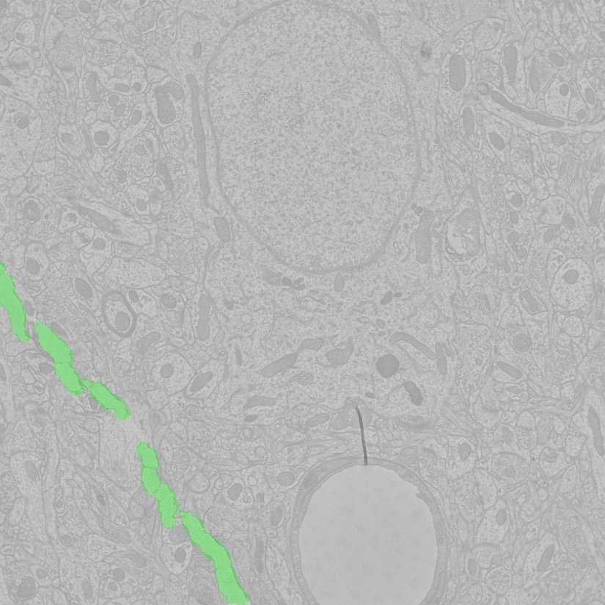
Improved Results (Cracks)
Original Prediction
New Prediction

Slide 48
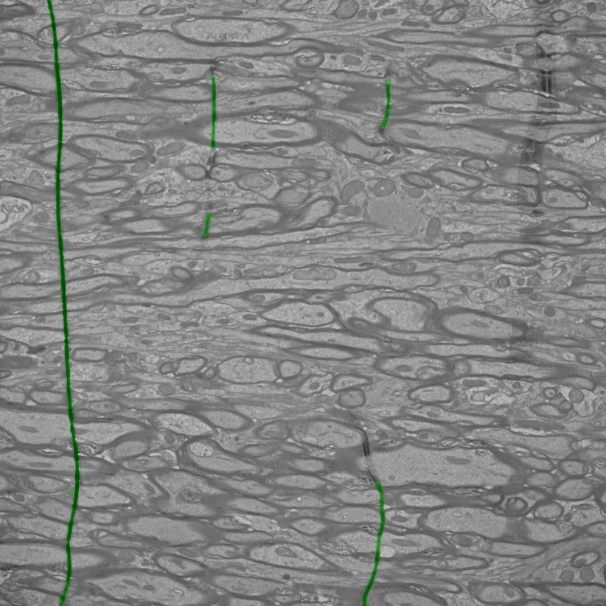
Improved Results (Folds)
Original Prediction
New Prediction

Slide 49
EM Team | AT Team | Our collaborators at HHMI
Agnes Bodor | Sharmishtaa Seshamani | Stefan Saalfeld
Casey Schneider-Mizell | Forrest Collman | Khaled Khairy
Clay Reid |  | Eric Trautman
Daniel Bumbarger
Daniel Kapner
Derrick Brittain
Joann Buchanan | Our Collaborators from Princeton
Marc Takeno
Nuno Da Costa | IARPA
Rob Young (PM)
Shelby Suckow (PM)
Tim Fliss (Technology)
Wenjing Yin

Slide 50
Phase 2 Improvements
Automated modules to identify stitching issues
Improvements for efficiently processing data
Perform stitching and alignment using mipmaps
Moving raw data to long term storage for lateral retrieval
Workflow manager for automated stitching and alignment
Pythonized modules to interact with Render and consumed by workflow manager
Scaling the solver to solve large systems across a distributed environment
Generation of statistical metrics to assess the quality of stitched and aligned volume

